Slide 1
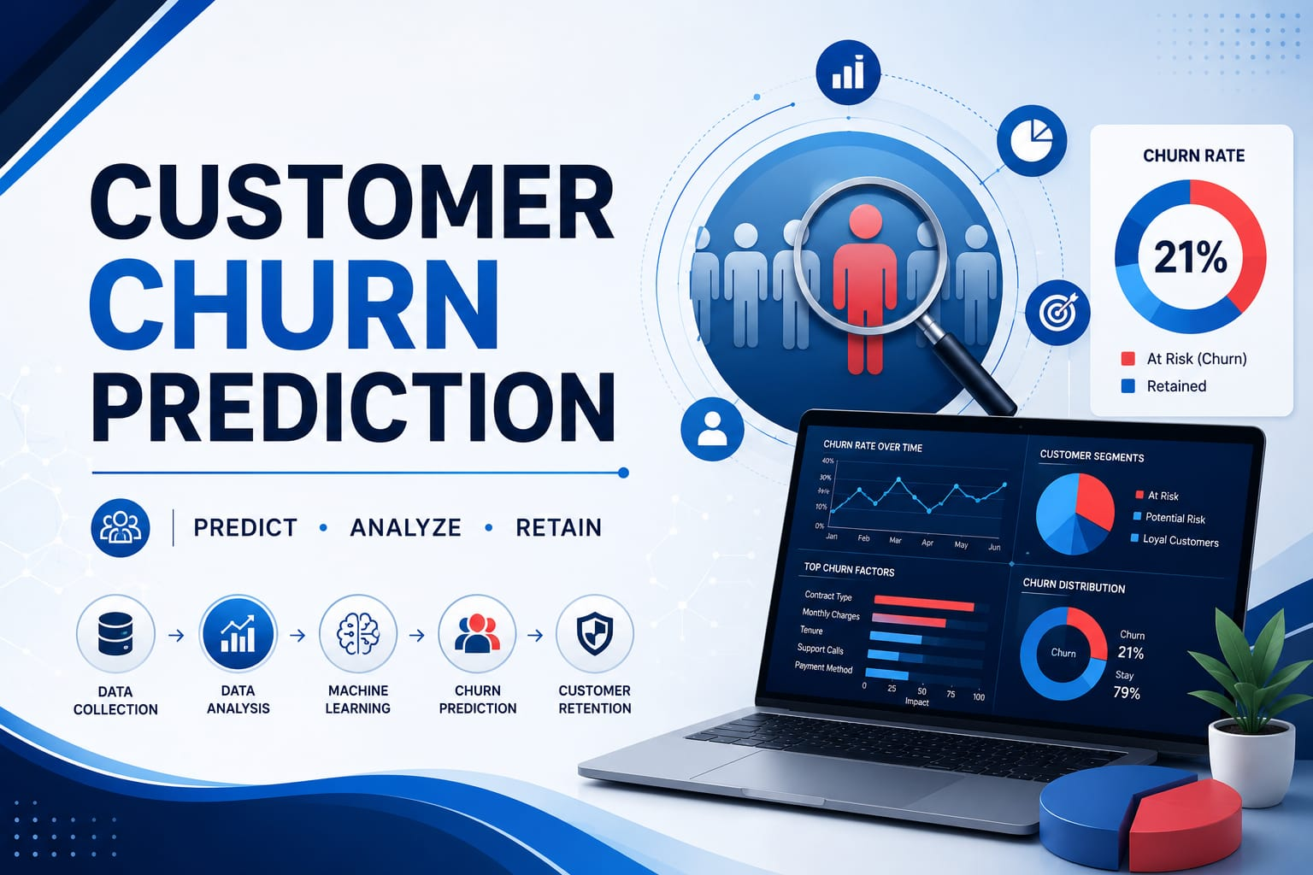

Slide 2
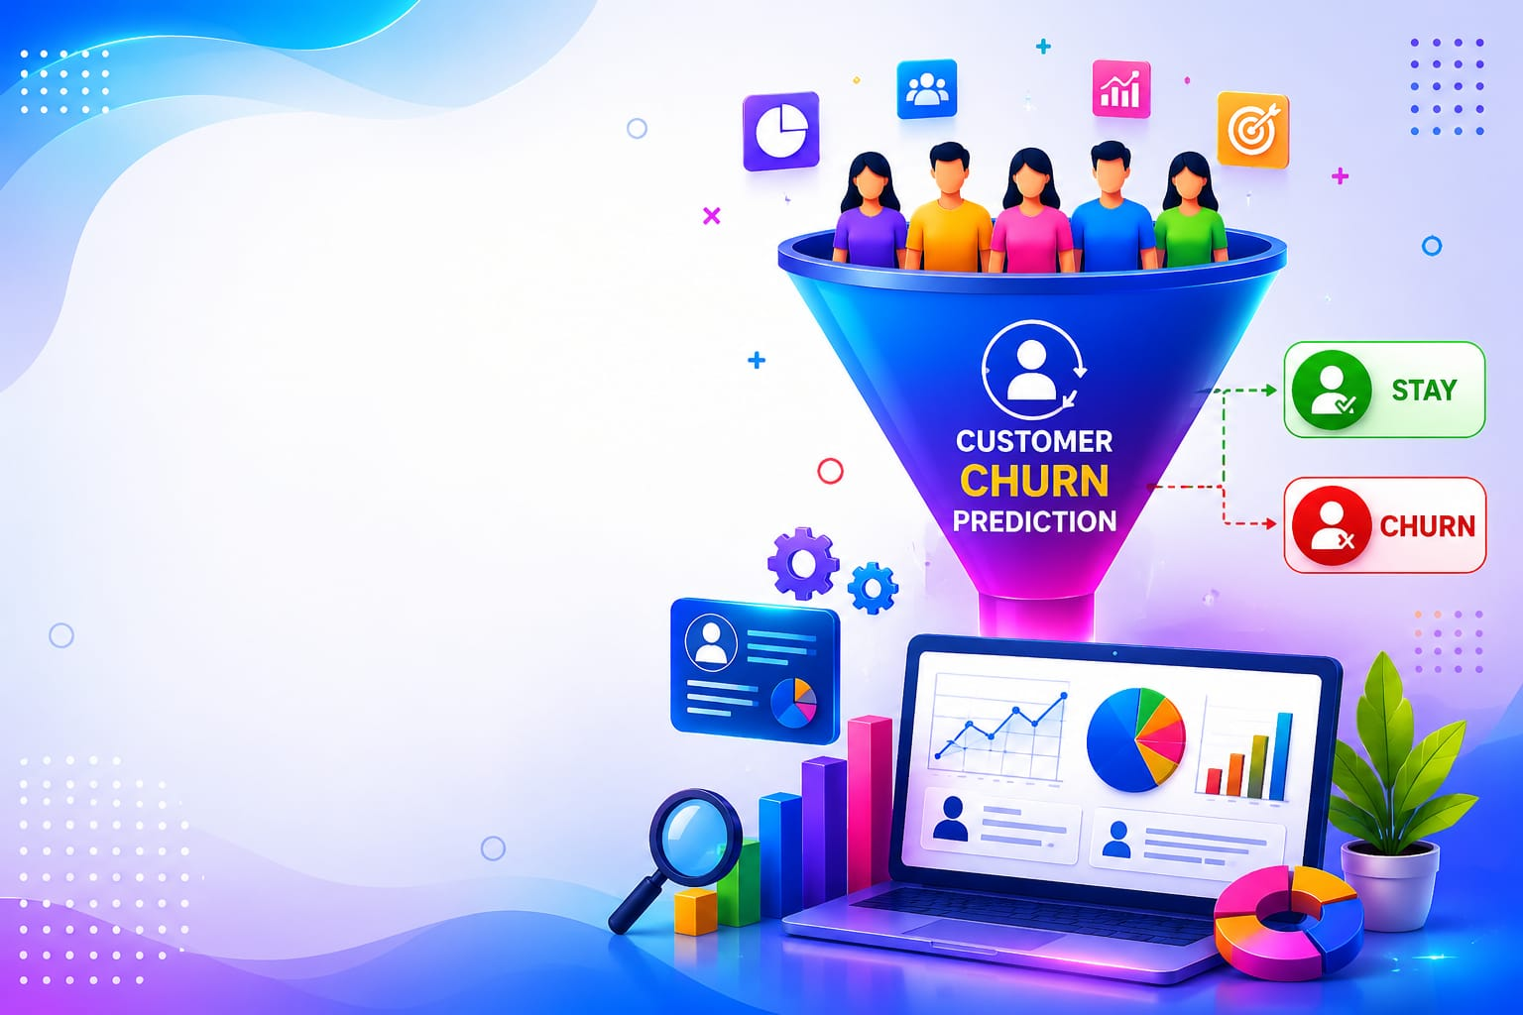
PROJECT TITLE : “CUSTOMER CHURN PREDICTION PROJECT “
NAME : ANNAMDEVULA DURGA PRASAD
INTERN ID : EDU-2026-355
DOMAIN : Data Science
DURATION : Two Months
COMPANY : EduTech Solutions

Slide 3
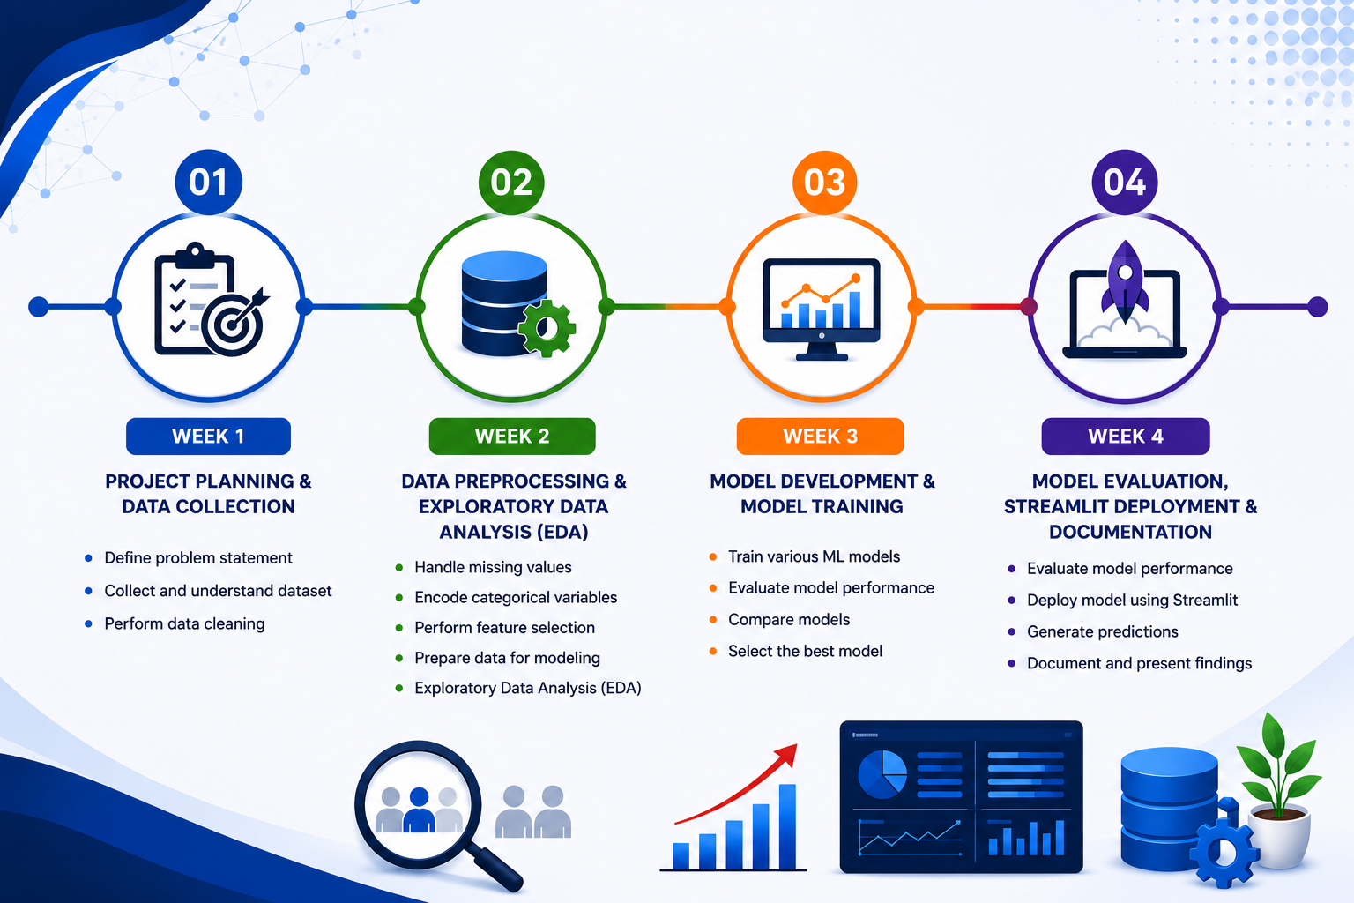
PROJECT TIME LINE PRESENTATION

Slide 4
Contents
Introduction
Company Overview
Objectives
Project overview
Methodology
Tools and Technologies
Output
Challenges And Learning
Conclusion
Future Scope

Slide 5
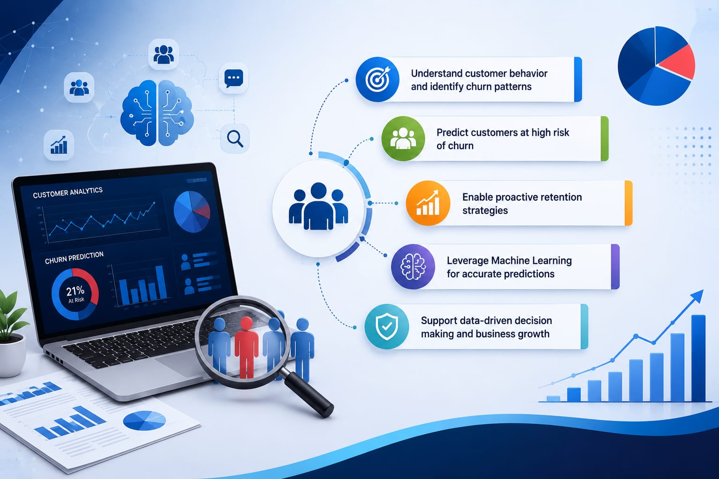
Introduction
Customer Churn Prediction is a machine learning project that predicts whether a telecom customer is likely to stay with the company or churn.
The project analyzes customer demographics, service subscriptions, account information, and usage patterns to identify the key factors influencing customer churn.
It aims to develop an accurate and reliable prediction model that helps businesses identify customers who are at risk of leaving.
The insights generated from the model support data-driven decision-making, improve customer retention strategies, and reduce customer churn.
The final machine learning model is deployed using Streamlit, providing an easy-to-use interface for predicting customer churn.

Slide 6

Company Overview
EduTech Solutions is an IT services and education technology company.
It provides internships, training, and skill development programs.
The company offers courses in AI, Data Science, Full Stack Development, Cybersecurity, and other emerging technologies.
It focuses on practical learning through hands-on projects and mentorship.
It helps students and fresh graduates develop industry-ready skills.
Its mission is to bridge the gap between academic learning and industry requirements.

Slide 7
Project Objectives
To predict whether a telecom customer is likely to stay or churn using machine learning.
To analyze customer demographics, service usage, and account information to identify factors influencing churn.
To preprocess the telecom customer dataset and build an accurate prediction model.
To evaluate the model using performance metrics such as accuracy, precision, recall, and F1-score.
To develop a Streamlit web application for real-time customer churn prediction.
To help businesses improve customer retention through data-driven decision-making.

Slide 8
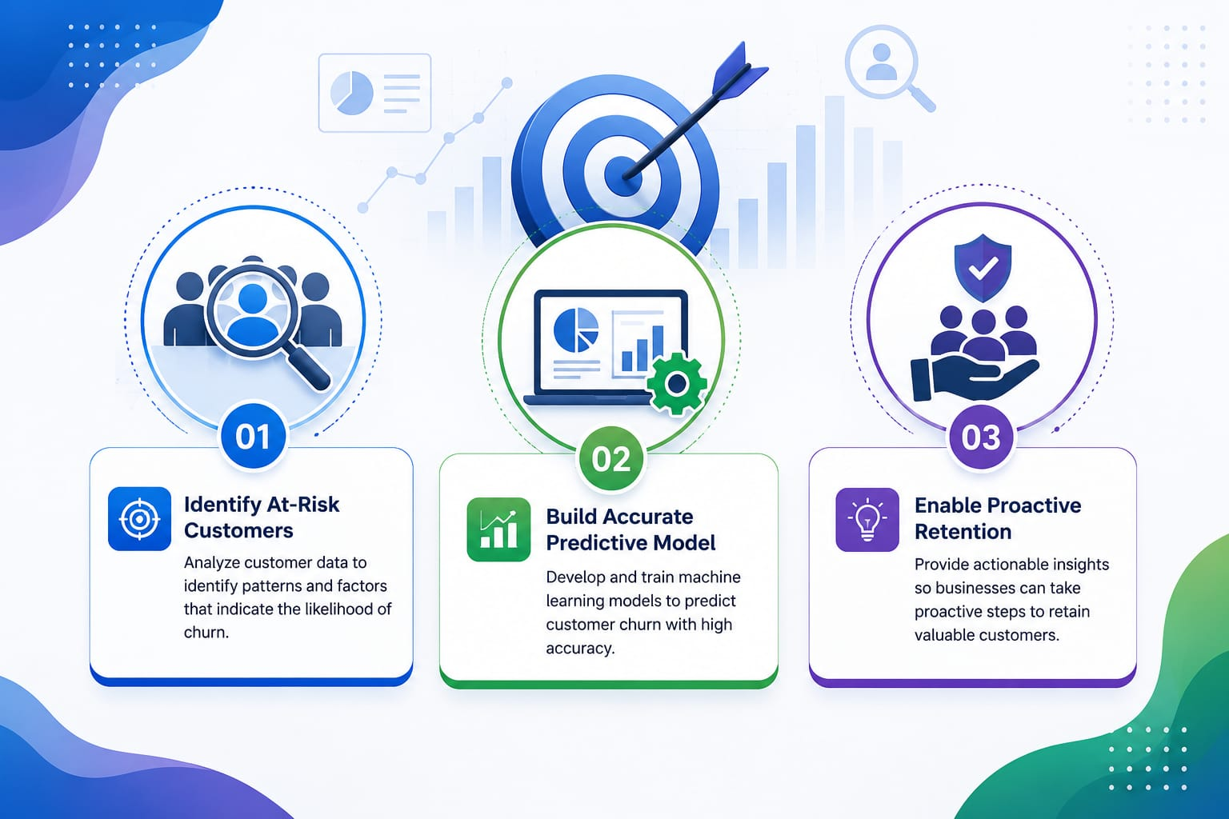

Slide 9
Methodology
Data Collection
Collect the telecom customer churn dataset.
Data Preprocessing
Clean the data, handle missing values, and encode categorical variables.
Exploratory Data Analysis (EDA)
Analyze customer behavior and identify churn patterns.
Train–Test Split
Split the dataset into training and testing sets.
Model Building
Train the Random Forest Classifier for customer churn prediction.
Model Evaluation
Evaluate the model using Accuracy, Precision, Recall, and F1-Score.
Prediction & Streamlit Deployment
Predict customer churn and deploy the final model using Streamlit for real-time predictions

Slide 10
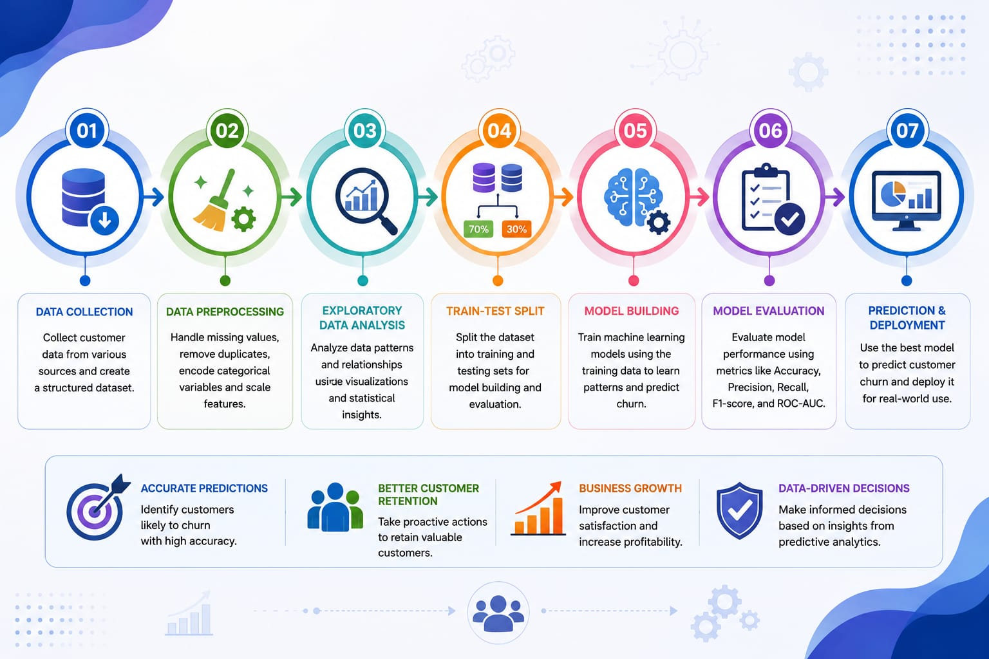

Slide 11
Project Overview
Problem Statement
Customer churn is a major challenge for telecom companies as it leads to revenue loss and increased customer acquisition costs.
This project uses machine learning to predict customers who are likely to leave the telecom service.
The prediction helps organizations take proactive measures to improve customer retention.
Project Scope
Analyzes customer demographic, service usage, contract, and billing information.
Identifies customers with a high risk of churn.
Supports telecom companies in making data-driven decisions and improving customer satisfaction.

Slide 12
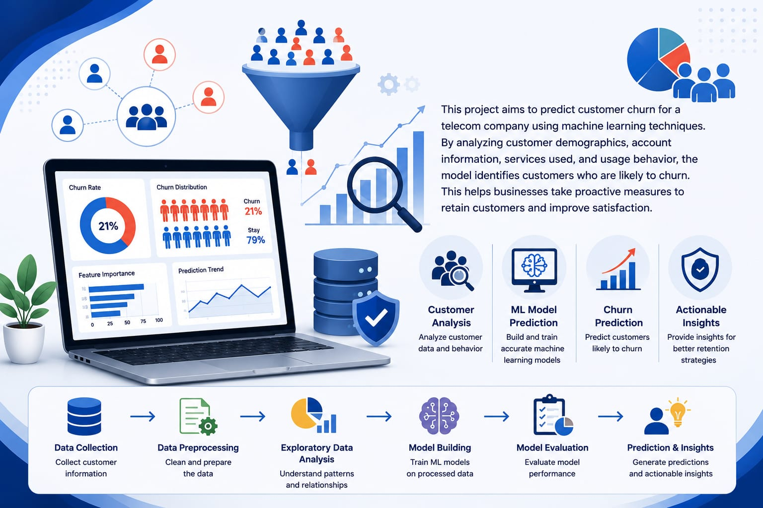
Project Approach
Collect And Preprocess The Telecom
Customer Dataset.
Perform Feature Selection And Train
Multiple Machine Learning Models.
Select The Best-Performing Model
Based On Evaluation Metrics.
Deploy The Final Model As A
Streamlit Web Application For
Real Time Churn Prediction.

Slide 13
Tools And Technologies
Programming And Development:
Python
Google collab
Git
Github
Machine Learning And Data Preprocessing:
Pandas
Numpy
Scikit-Learn
Random Forest Classifier

Slide 14
Joblib
Visualization And Deployment:
Matplotib
Seaborn
Streamlit
Telecom Customer Churn Dataset
Model Evaluation Metrics

Slide 15
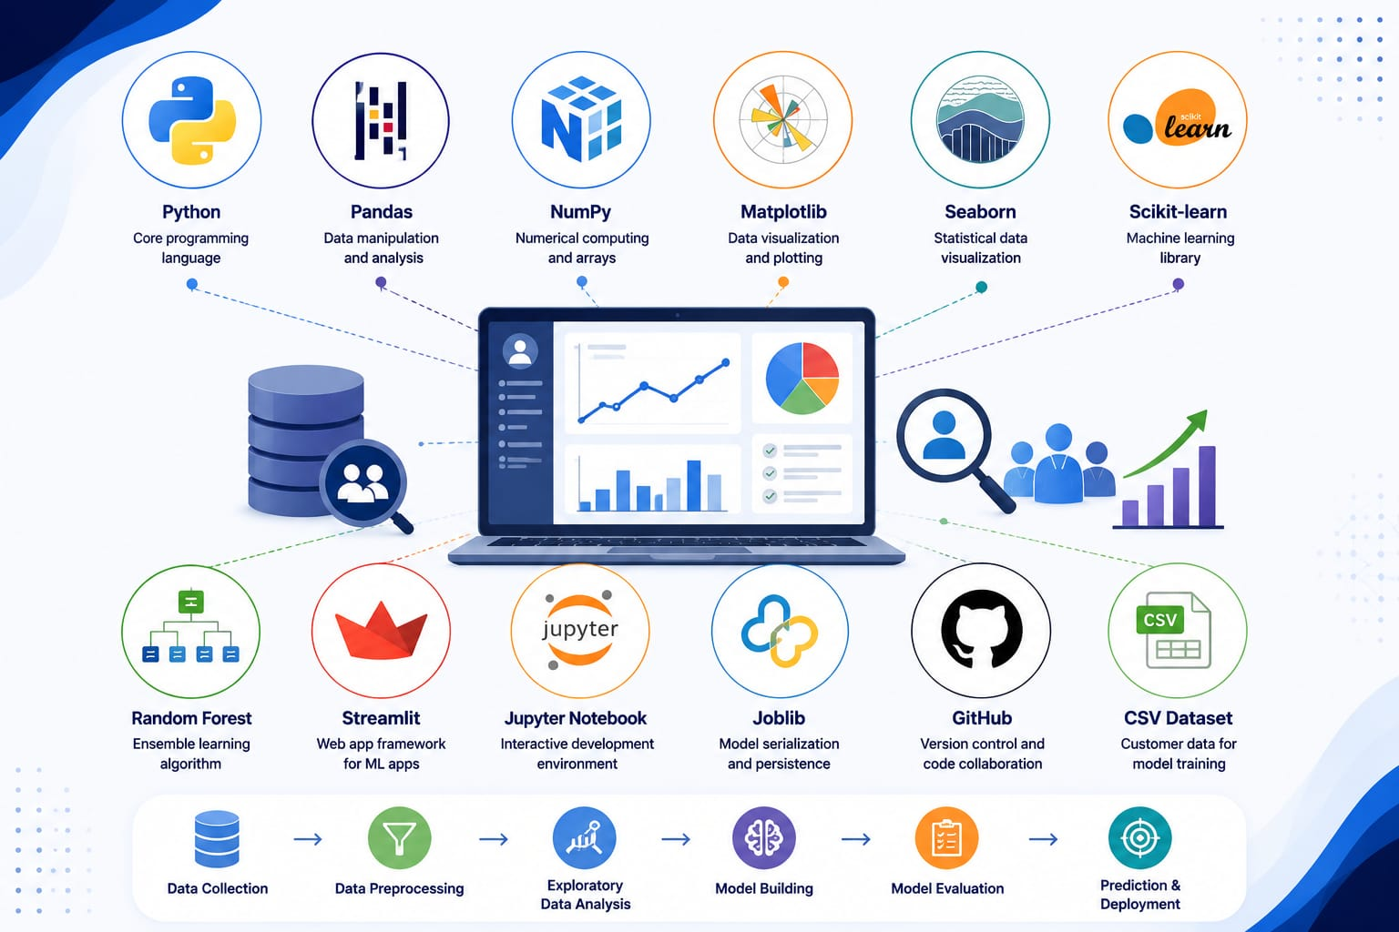

Slide 16
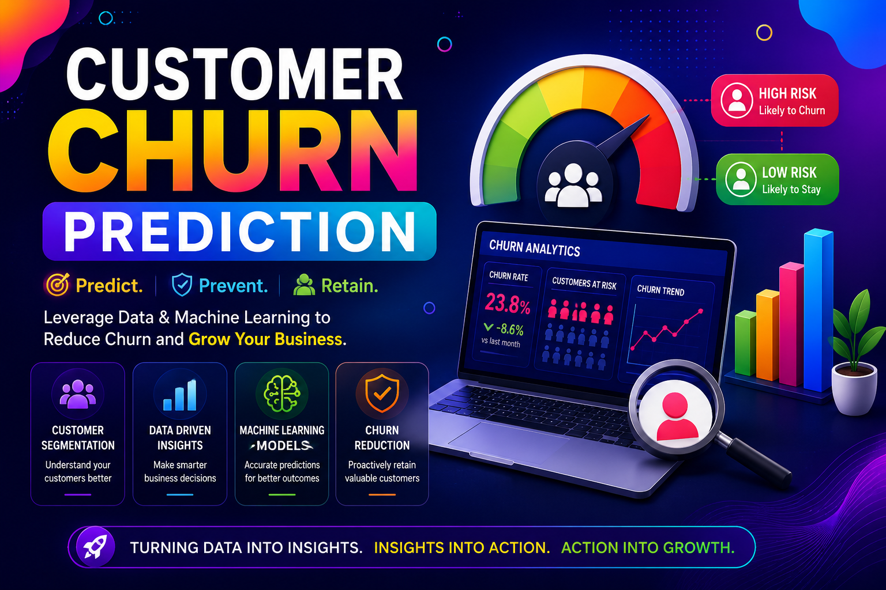
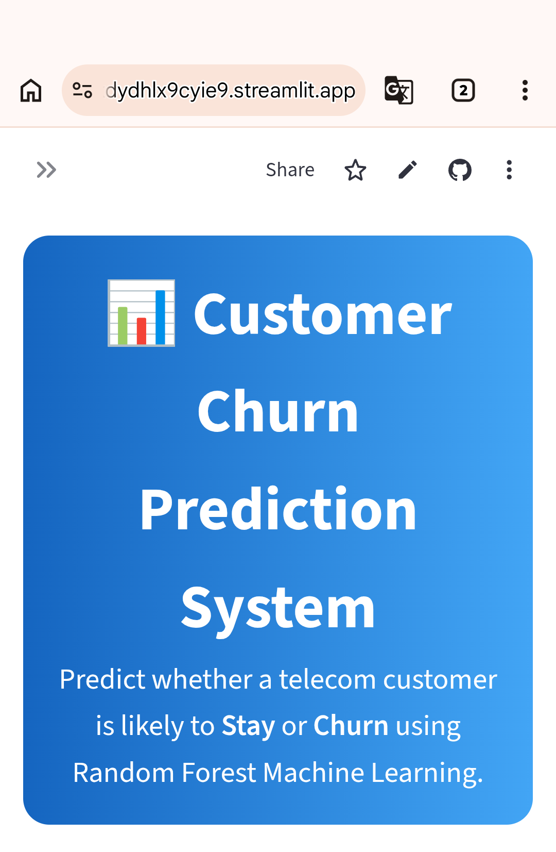
Output

Slide 17
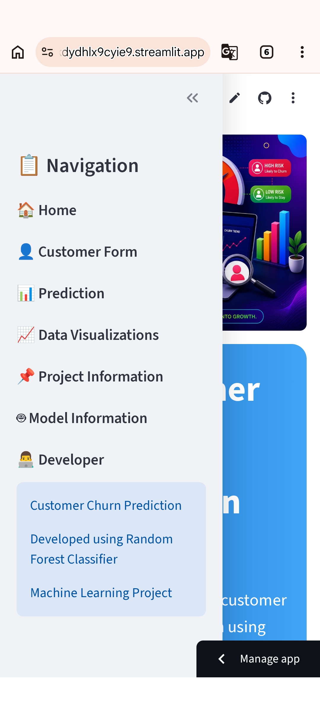

Slide 18
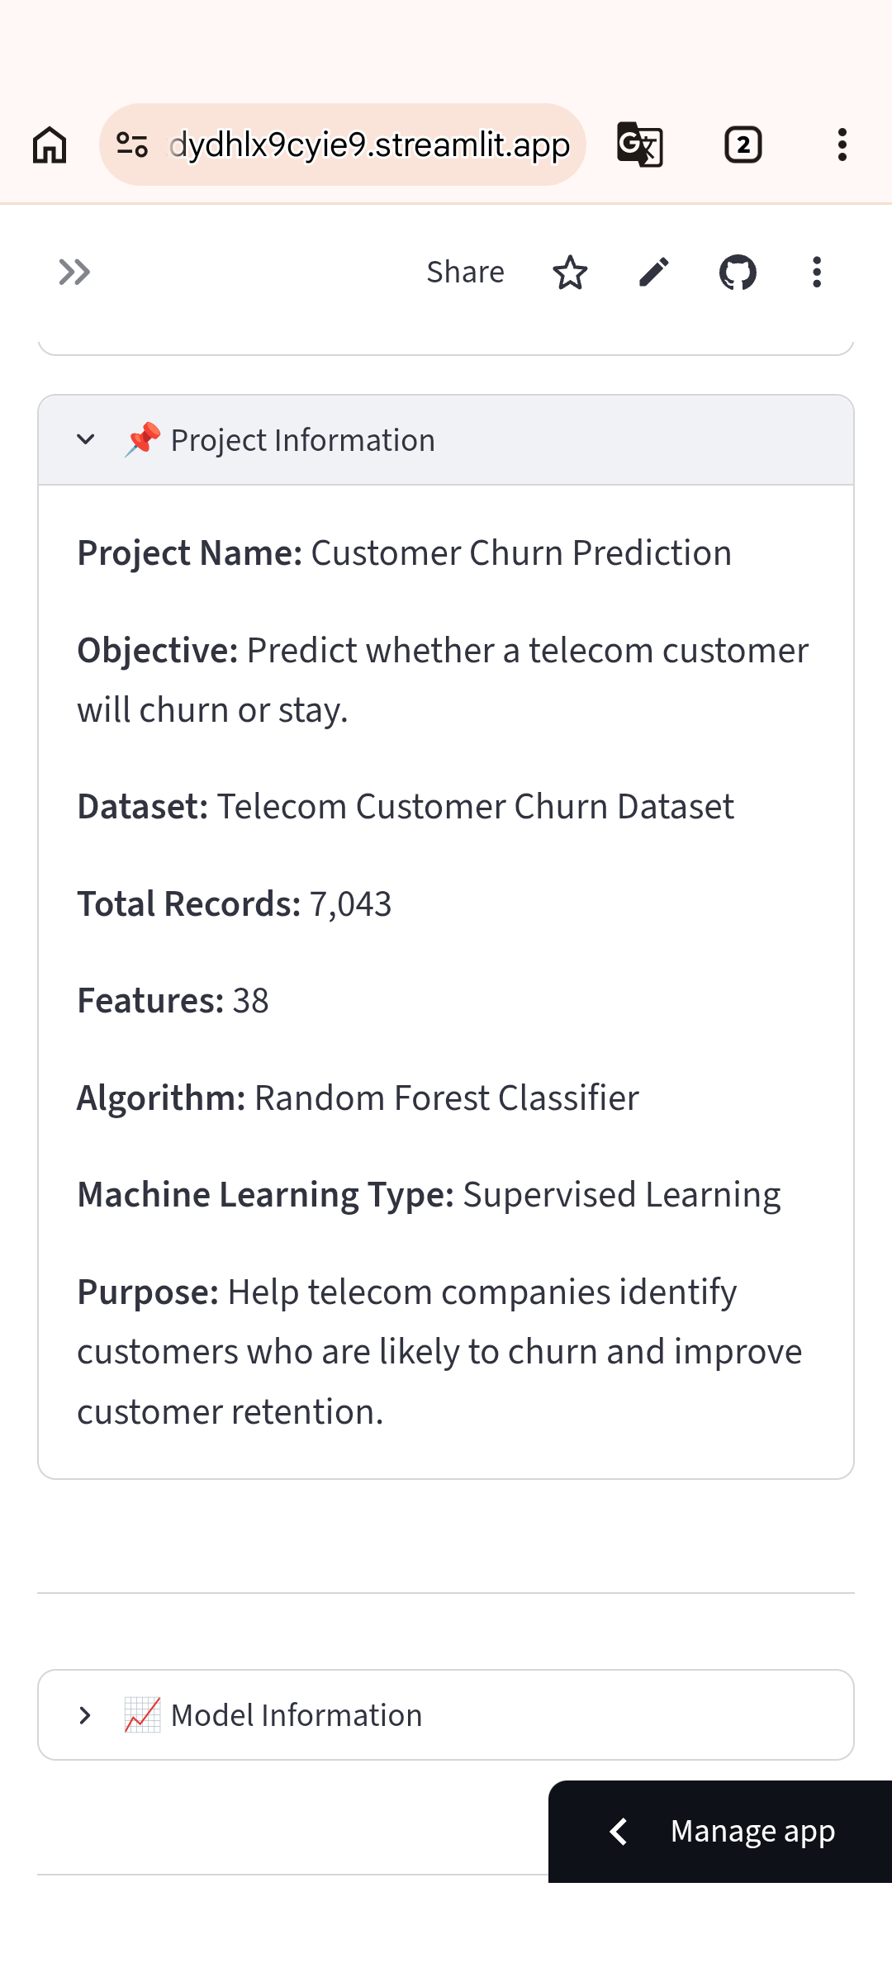

Slide 19
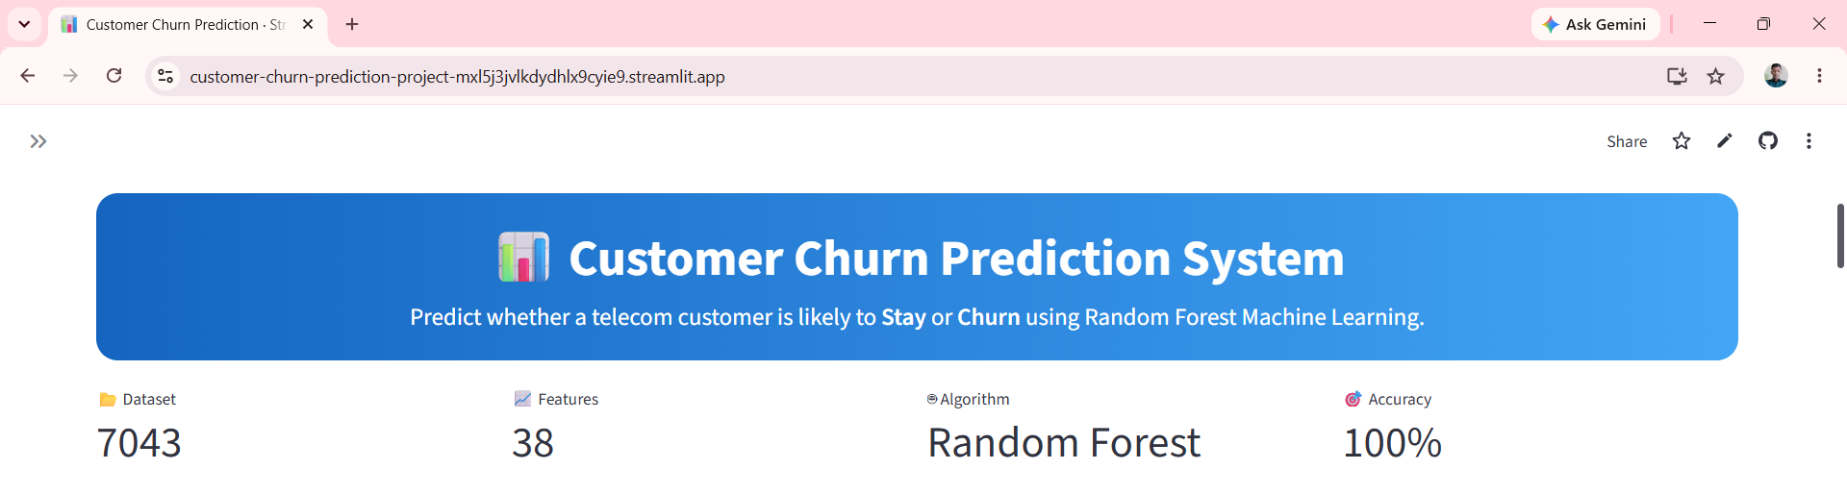

Slide 20
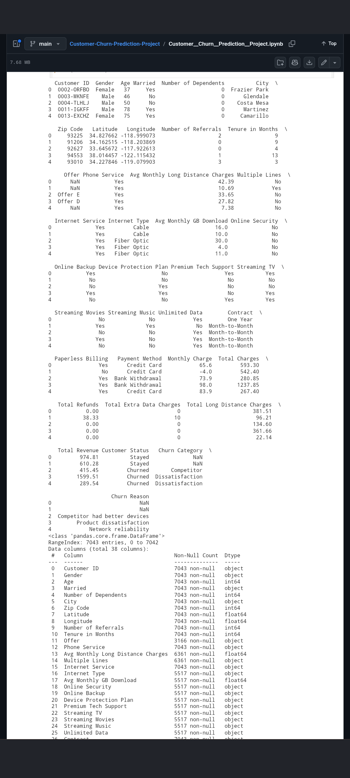

Slide 21
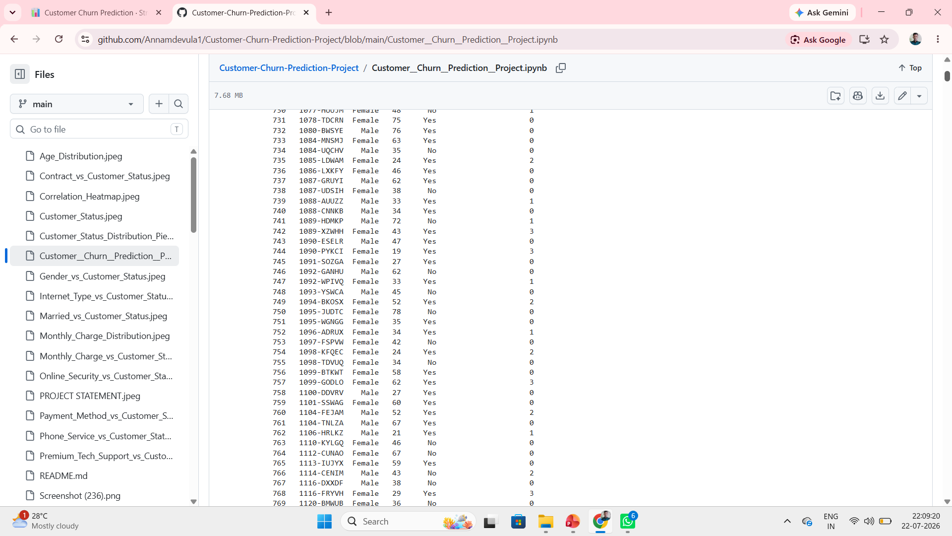

Slide 22
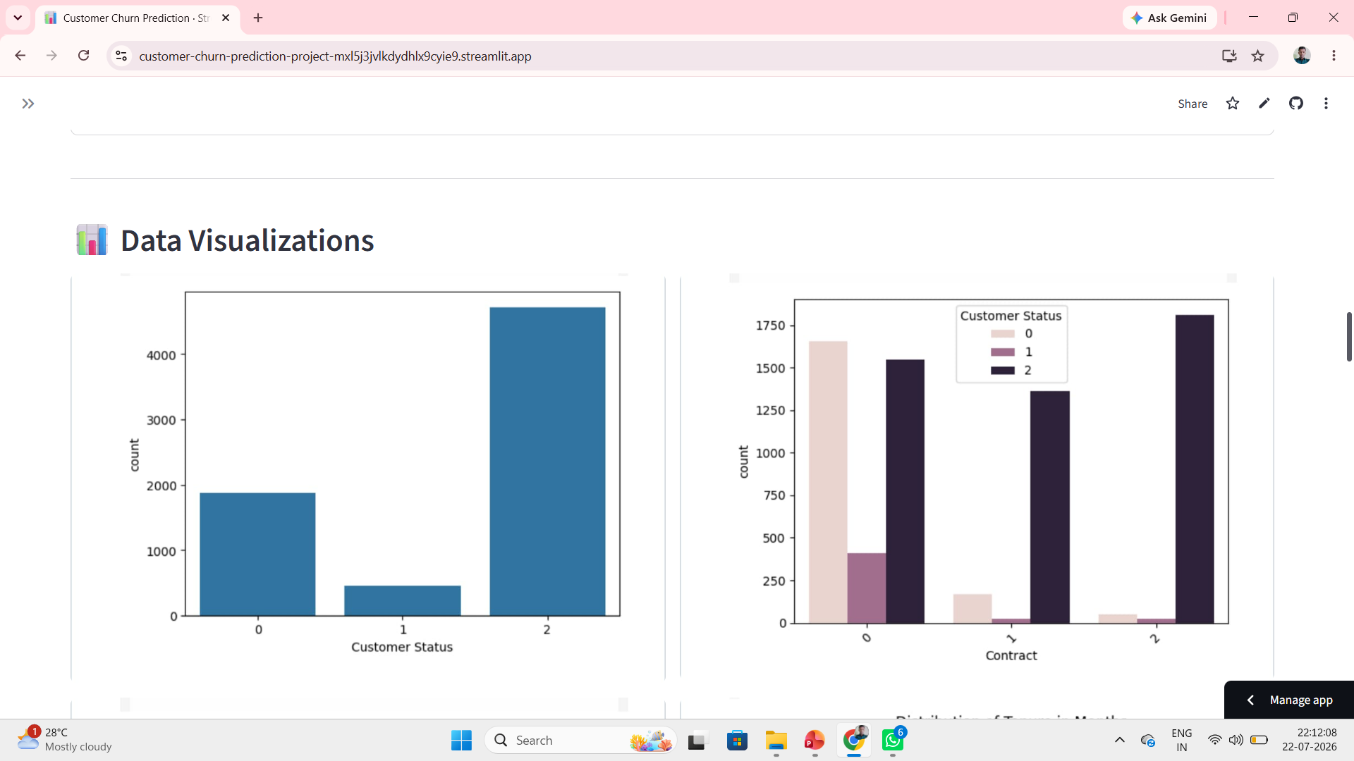

Slide 23
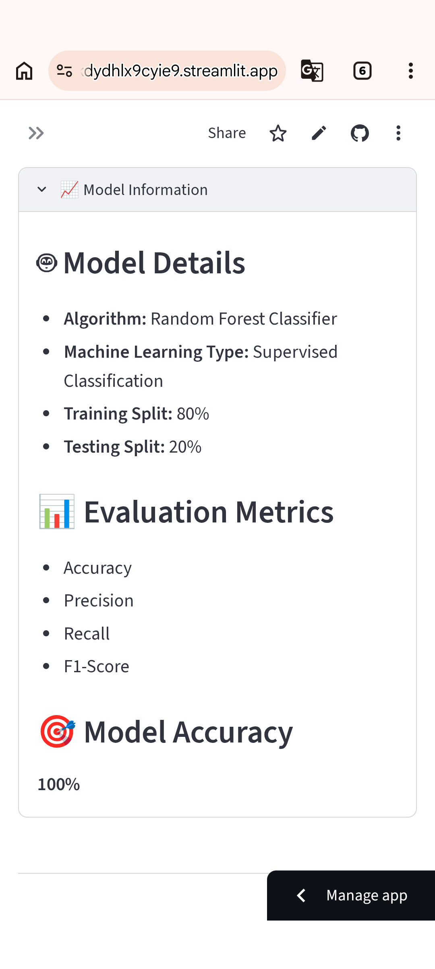
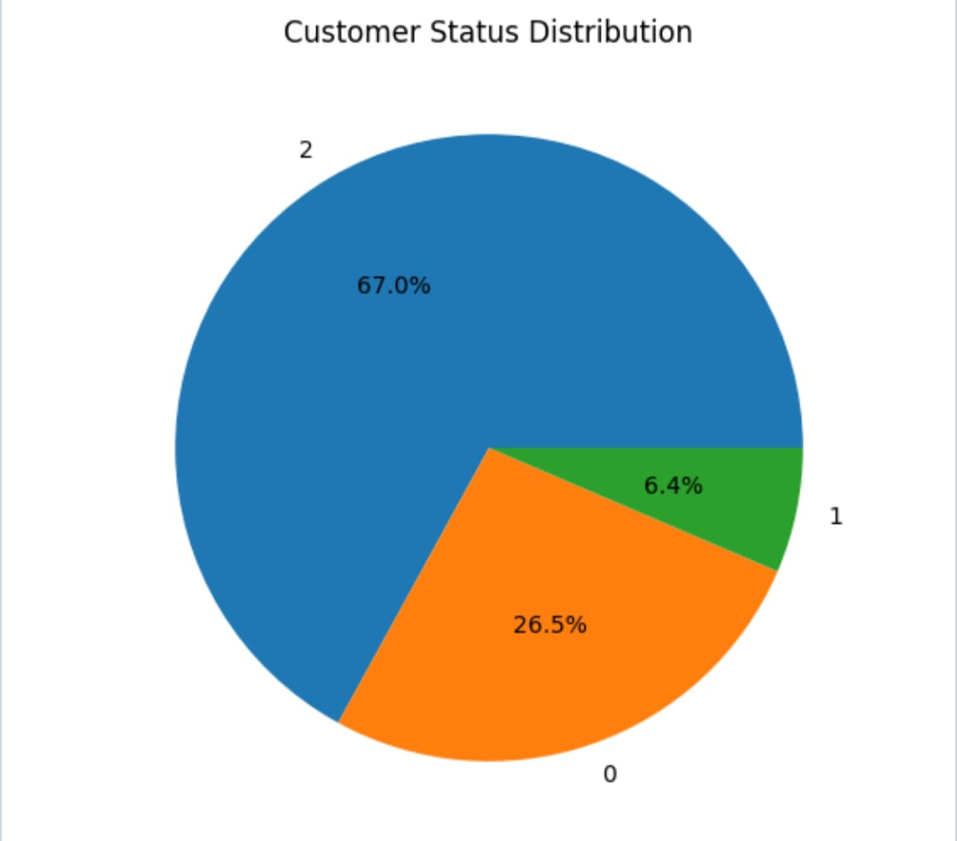

Slide 24
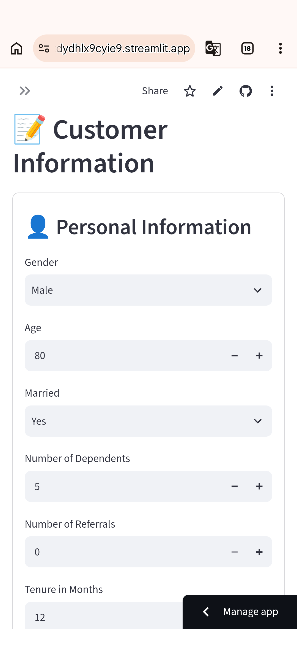
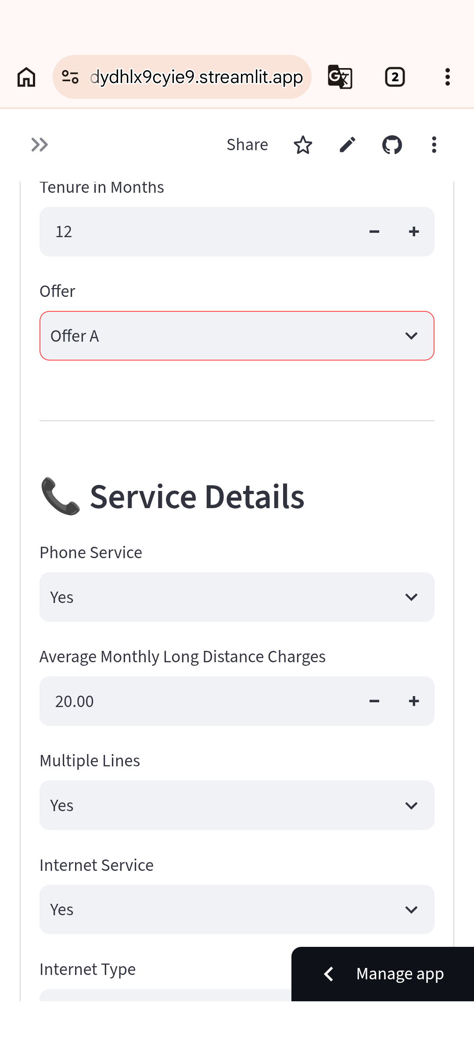

Slide 25
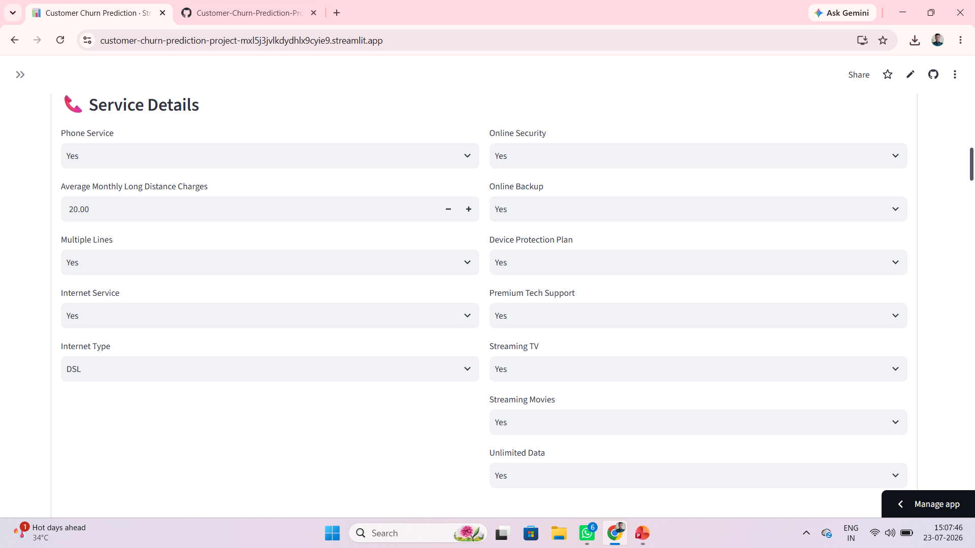

Slide 26
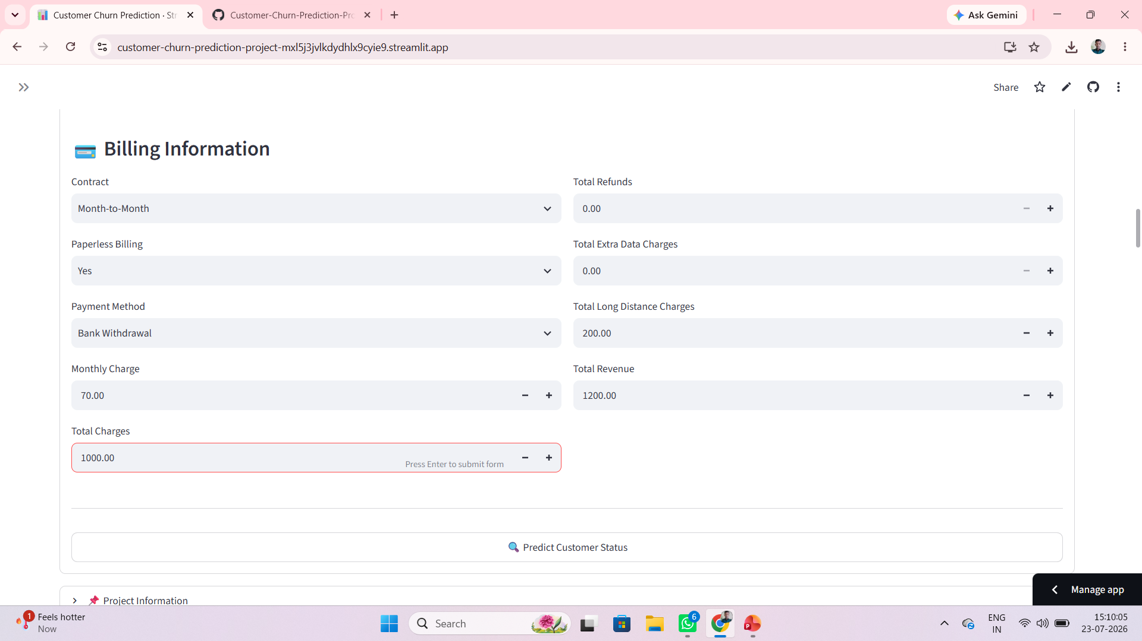

Slide 27
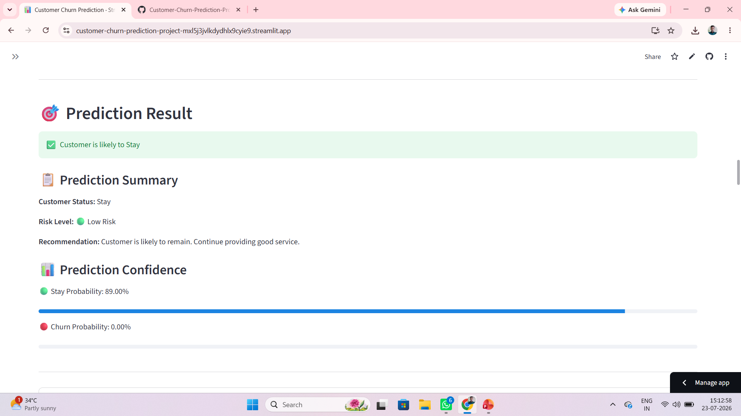

Slide 28
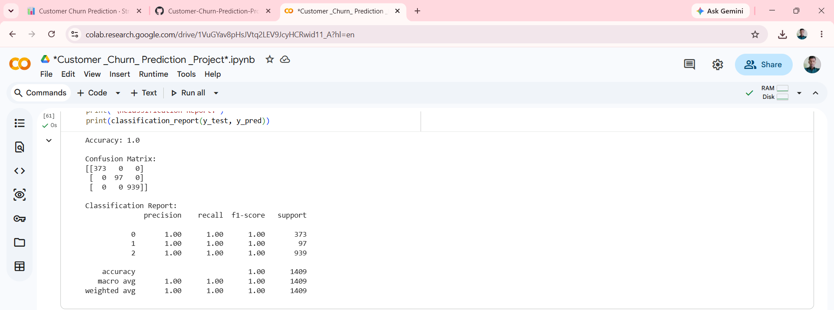

Slide 29
Challenges And Learning
Data Preprocessing
Challenge: Preparing the dataset for training.
Solution: Cleaned the data and encoded categorical features.
Feature Selection
Challenge: Identifying important features.
Solution: Selected the most relevant features using EDA.
Model Selection
Challenge: Choosing the best machine learning model.
Solution: Selected the Random Forest model for better performance.
Application Development
Challenge: Developing a prediction application.
Solution: Built and tested the application using Streamlit.

Slide 30
Learning
Learned data preprocessing.
Gained experience in machine learning.
Improved data analysis skills.
Learned model evaluation.
Developed a Streamlit application.
Enhanced problem-solving skills.

Slide 31
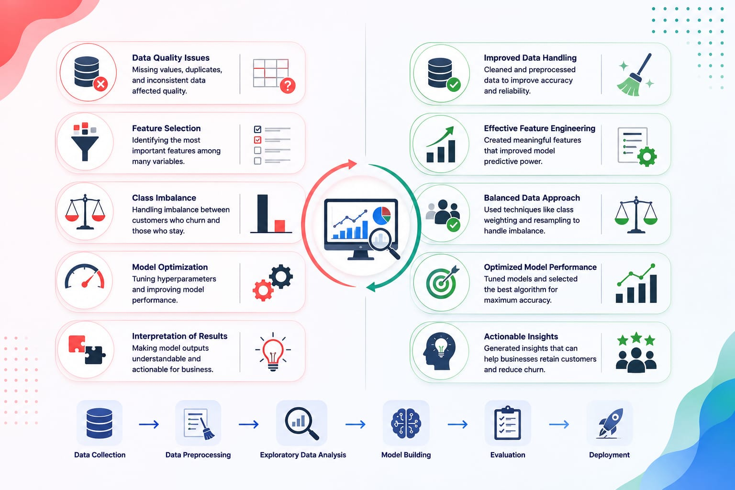

Slide 32
Conclusion
Developed a machine learning model to predict customer churn effectively.
Analyzed customer data to identify patterns influencing churn.
Used the Random Forest algorithm to achieve reliable prediction accuracy.
Created a Streamlit web application for easy and real-time predictions.
Visualized customer trends using interactive charts and graphs.
The project helps businesses identify at-risk customers early.
Supports data-driven decisions to improve customer retention.
Can reduce customer loss and increase overall business growth.
Demonstrates the practical application of machine learning in business.
Provides a strong foundation for future enhancements and deployment.

Slide 33
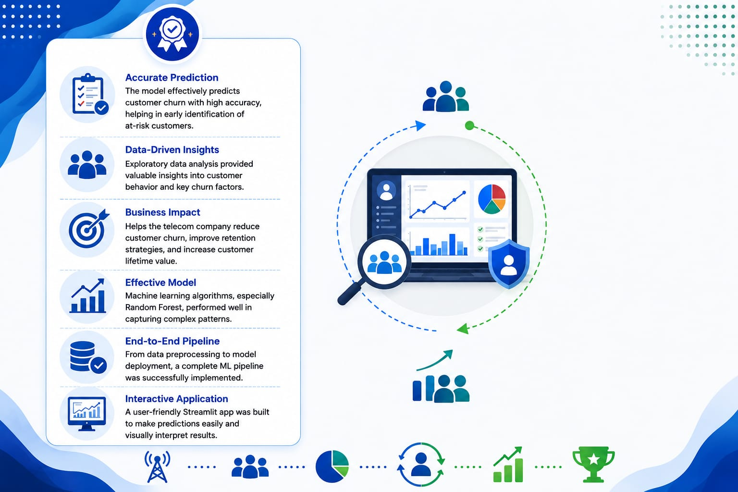

Slide 34
Future Scope
Enhance The Model By Incorporating Additional Customer Behaviour And Transaction Data.
Improve Prediction Performance Through Regular Model Updates And Retraining With New
Datasets
Implement Automated Retention Campaigns based on Churn Prediction Results.
Develop An Interactive Analytics Dashboard With Advanced Reporting Features.
Integrate The System With Customer Relationship Management (CRM) Platforms For Seamless Business Operations.
Extend The Application To Support Multiple Industries Such As Banking, Retail, Healthcare, And E-commerce.

Slide 35
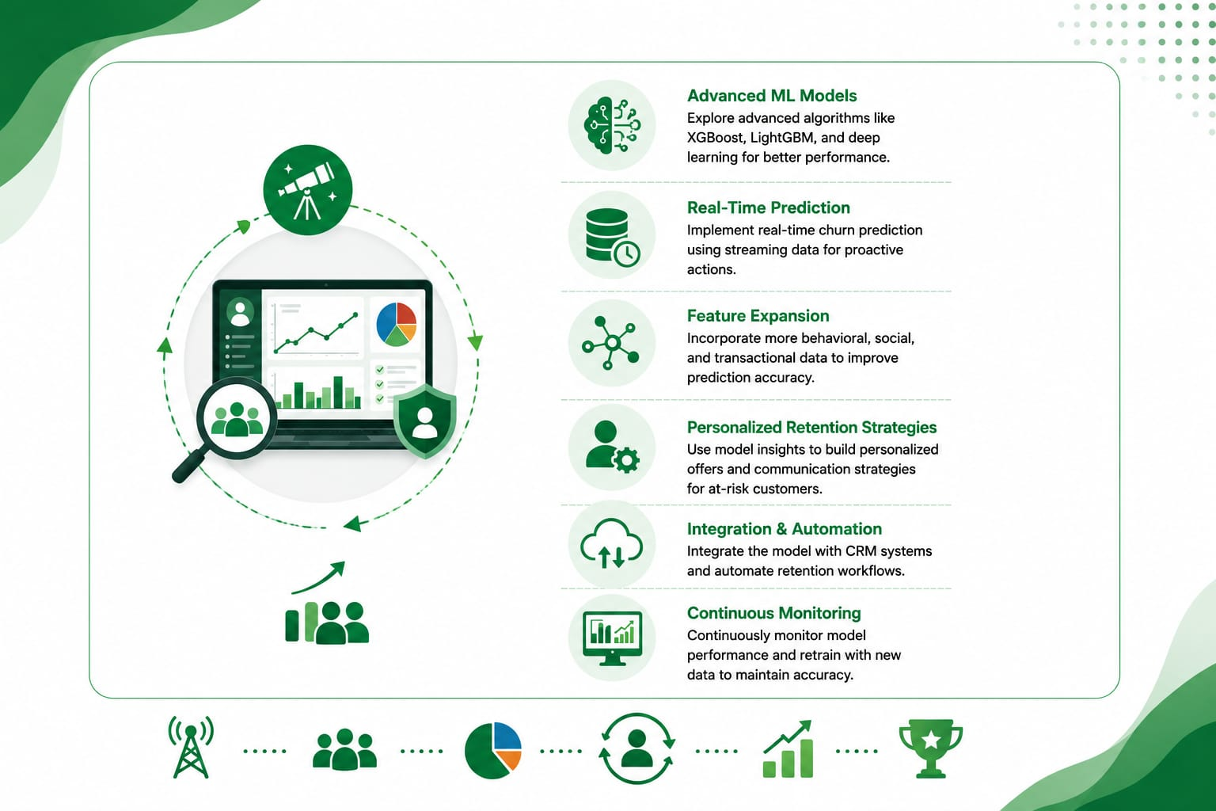

Slide 36

“THANK YOU “

